Slide 1
QORSHAHA XEELADA DEGMADA 2019-2024
KORMEERAHA GUUD, DR. BRENDA CASSELLIUS

Slide 2
Dugsiyada Dadweynaha ee Boston
MAWDUUCA
Ujeedooyinka:
La wadaag himilooyinka BPS iyo mudnaanshaha;
Uruuri macluumaadka iyo jawaab-celinta si loo horumariyo qiimayaasha la wadaago, yoolalka, iyo waxyaabaha mudnaanta la siinayo;
Soo Dhaweyn & Isbarasho
Fariin Fiidiyoow Dhanka Dr. Cassellius
Dulmarka Qorshaha Istiraatiijiga ah ee Degmada, Himilooyinka, iyo mudnaanaha
Dood-wadaaga kooxda yar
Xiritaanka & Talaabooyinka Xiga

Slide 3
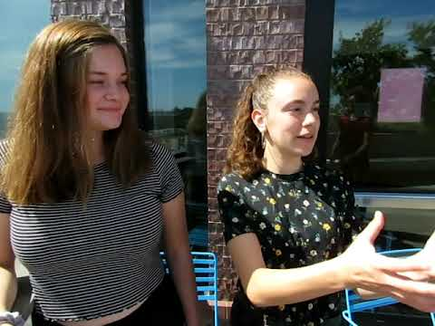

Slide 4
3. XAQIIJIN
1. WAREEG
BULSHADA
2. URUURIN

Slide 5
WAREEG
URUURIN
XAQIIJIN
9/20
10/20
11/20
12/20
1/20
2/20
Socdaalka Kaqeybgalka Bulshada
Socdaalka Kaqeybgalka Bulshada
Socdaalka Kaqeybgalka Bulshada
Dib-u-eegista Qorshaha Istaraatiijiyadeed
Qoraalka ugu dambeeya ee qorshaha istiraatiijiyadeed
Socdaalka Kaqeybgalka Bulshada
Booqashada Dugsiyada
Kulamada Bulshada
Kulamada SPC
Booqashada Dugsiyada
Kulamada Bulshada
Kulamada SPC
Booqashada Dugsiyada
Kulamada Bulshada
Kulamada SPC
Booqashada Dugsiyada
Kulamada Bulshada
Notes:
Dr. Cassellius:
Shayga muhiimka ah in la xuso, waa in ADIGA, bulshada, aad wargaliso qorshaha istiraatiijiyadeed! Markii socdaalkeygu ku soo gabagaboobo dhammaado, waan sameyn doonaa:
Waxaan booqday dhammaan 125-ka dugsi ee degmada
Kaqeybgalay 26 wada sheekeysiga bulshada oo ku baahsan magaalada oo dhan, 70% oo ay marti galin doonaan ururada bulshada ee u adeegaya dadka taariikhiga ah ee la soocay.
La kulmay 44 u doodid, samafal, shirkad, caqiido ku saleysan iyo kuwa aan macaash doon ahayn
Marti galiyay 6 shirarka Golaha Waalidka Dugsiga ee gobolka
Iyo ka soo qayb galeen dhacdooyin badan oo bulshada aan rasmi ahayn
Dhammaan jawaab-celintaada waxay gacan ka geysan doontaa in la wargeliyo qorshaha istiraatiijiyadeed ee la dhammeystiri doono Febraayo 2020.

Slide 6
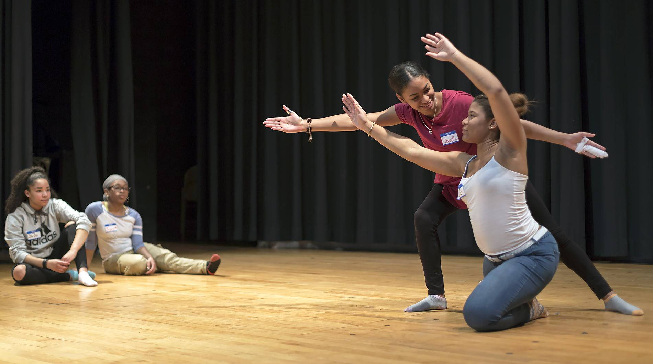
Dugsiyada Dadweynaha Boston
HIMILADA DEGMADA
Natiijooyinka ardayda la wanaajiyey
Tayada dugsiga oo la wanaajiyey
Degmo xoogan hoggaamin / tayo sare, macallimiin ku habboon ficil iyo shaqaalaha
Qoondaynta kheyraadka wax ku oolka ah
Maalgashiga bulshada ee weyn

Slide 7
Dugsiyada Dadweynaha Boston
GOOBAHA MUDNAANTA
Rajo
sare
dhamaan
Manhaj
Adag
Helitaan loo wada siman yahay
Kala duwanaansho, shaqaale tayo sare leh
Taageero Kordhay/ isla xisaabtan
Kordhin madax-bannaanida

Slide 8
Dugsiyada Dadweynaha Boston
EL adag iyo Isugeynta SPED
Meel lagu cayaaro bannaanka iyo gudaha
Muusiga iyo Farshaxanka
Sayniska iyo Jadwal Tiknoologiyada
Muhiimka Tacliinta
Kaqeybgal wax ku ool ah ardayda iyo qoysaska
Macallimiinta Kala Duwan, Hoggaamiye yaasha Dugsiga iyo Shaqaalaha Taageerada ee Iskuulada (midab, isir iyo luqadeed)
Xudunta Xoogan iyo Heerka HS
Casriga Bulshada Dugsiga
Barnaamijyada Dugsiga kahor iyo kadib
DUGSIYO TAYO SARE LEH

Slide 9
Hadda iyo Goobaha Suurtogal ah ee Maalgashi
 | Natiijooyinka ardayda la wanaajiyey | Tayada dugsiga la wanaajiyey | Hogaanka degmada ee adag /tayo sare, macallimiin ku saleysan waxqabadka iyo shaqaalaha | Qoondaynta kheyraadka wax ku oolka ah | Maalgashiga bulshada ee weyn
Dhis BPS | ✔ | ✔ |  | ✔ | ✔
Xulashada Dugsiga | ✔ | ✔ |  | ✔ | ✔
Academic Rigor / MassCore | ✔ | ✔ | ✔
Tayo Sare/ Dugsiyada Hub | ✔ | ✔ | ✔ | ✔ | ✔
Ku darista | ✔ | ✔ |  | ✔
EFA | ✔ | ✔ | ✔ | ✔
CLSP (Dhaqan ahaan iyo Luuqad ahaan Joogtaynta Dhaqamada) | ✔ | ✔ | ✔ |  | ✔
Kulliyadda, Xirfadda, iyo Ololaha Nolosha | ✔ | ✔ | ✔ |  | ✔

Slide 10
Dood Kooxeed Yar
Tilmaamaha:
Ku soo biir kooxdaada wada hadalka. Ka wada hadla su'aalaha soo socda. Xullo weriye si aad ula wadaagto hal muuqaal oo ka mid ah su'aalaha.
Su’aalaha:
Kuwanu ma yihiin hadafyo istiraatiiji ah oo sax ah? Maxaa ka maqan? Ma jiraan wax ay tahay inaan meesha ka saarno?
Ku saleeysan meelahan, noocee barnaamijyada, fursadaha iyo taageerada loo baahan yahay si loo dhammaystiro aragtidaada iskuullada tayada leh?

Slide 11
www.bostonpublicschools.org
communityengagement@bostonpublicschools.org
FARXAD
MIDNIMO
KU DARIS
ISKAASHI
SINAAN

